Slide 1
Microsoft Power BI

Slide 2
Setting Datasource Credentials with the Power BI REST API
Ted Pattison
Principal Program Manager
Power BI Customer Advisory Team (PBICAT)

Slide 3
Agenda
Programming Datasets with the PBI REST API
Programming Datasets as Service Principal
Scaling with App-Owns-Data in Multi-tenant Scenarios

Slide 4
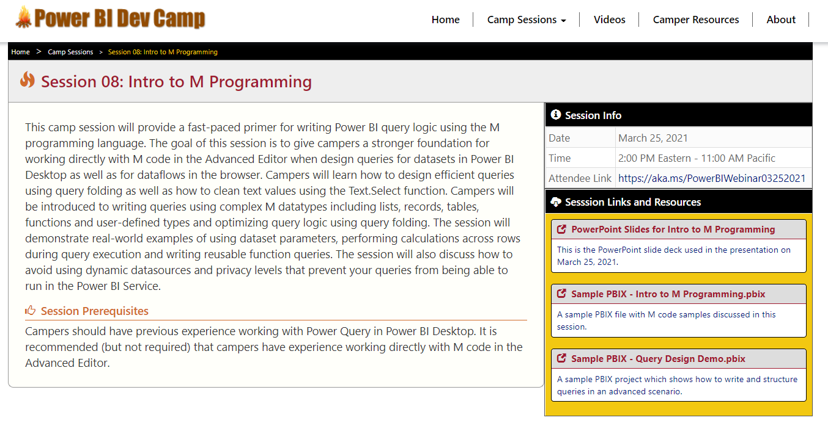
Welcome to Power BI Dev Camp
Power BI Dev Camp Portal - https://powerbidevcamp.net

Slide 5
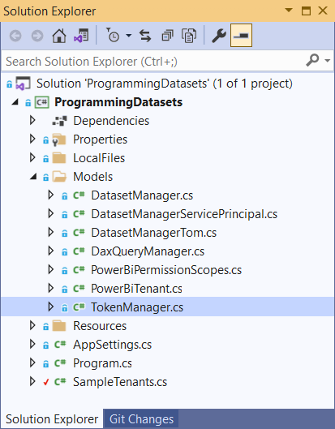
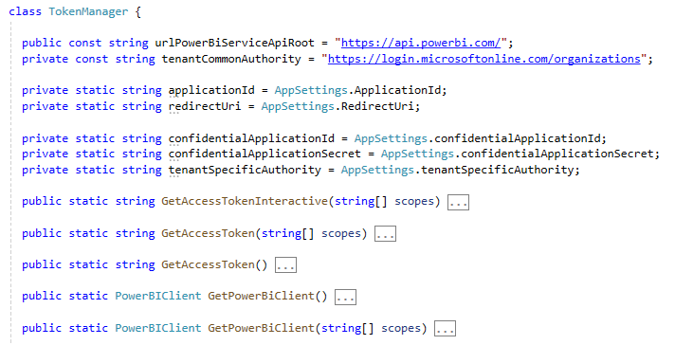
TokenManager class implements authentication flows

Slide 6
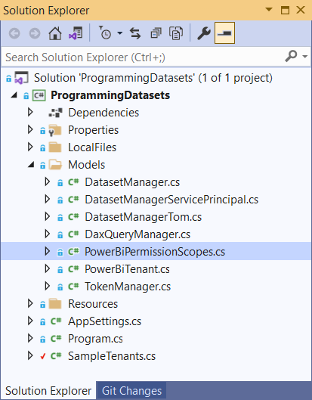
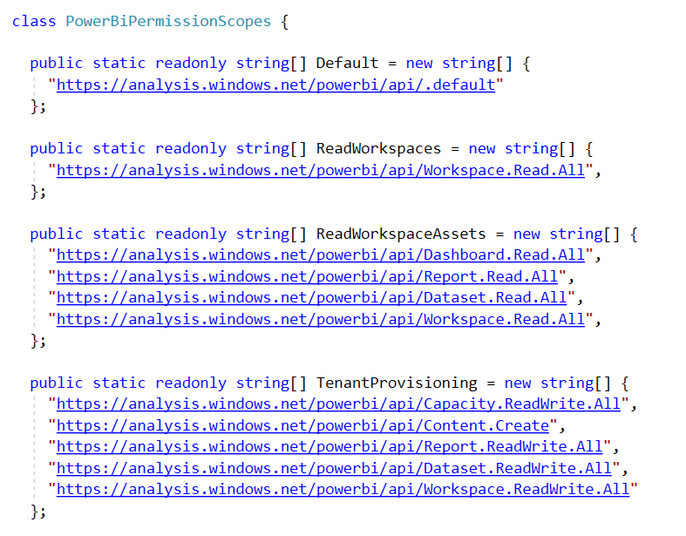
Power BI - Delegated Permission Scopes

Slide 7
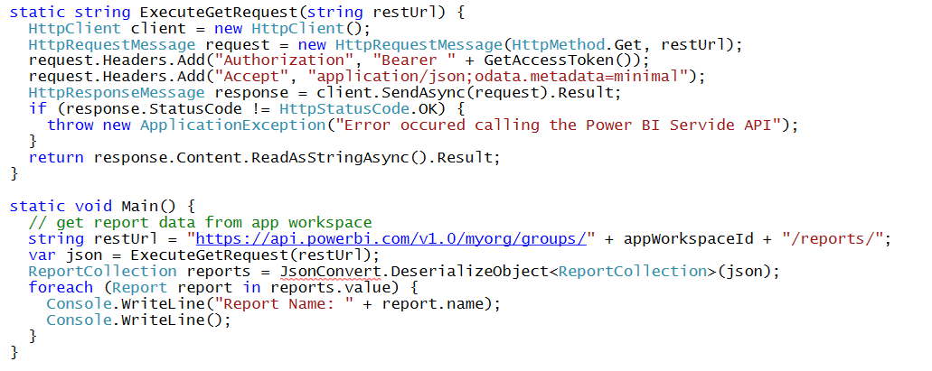
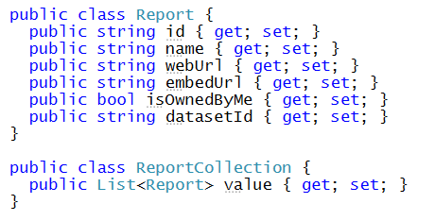
Calling Directly to the Power BI Service API This is a sample of C# code that does not use the Power BI .NET SDK
Your C# Code
Power BI
Service API
Executing HTTP Requests
Capturing HTTP Responses
Serializing/Deserializing JSON

Slide 8
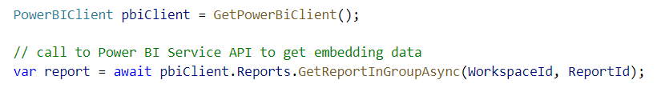
Power BI .NET SDK
Developing without the Power BI .NET SDK
Developing with the Power BI .NET SDK
Your C# Code
Power BI
Service API
Executing HTTP Requests
Capturing HTTP Responses
Serializing/Deserializing JSON
Your C# Code
Power BI
Service API
Power BI .NET SDK
Executing HTTP Requests
Capturing HTTP Responses
Serializing/Deserializing JSON

Slide 9
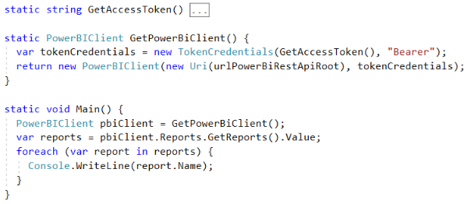
Initializing an Instance of PowerBIClient
PowerBIClient object serves as top-level object
Used to execute calls against Power BI Service
Initialized with function to retrieve AAD access token

Slide 10
User APIs versus Admin APIs
Power BI User APIs (e.g. GetGroupsAsync)
provides users with access to personal workspace
provides users with access to app workspaces
provides service principal (SP) with access to app workspaces
Power BI Admin APIs (e.g. GetGroupsAsAdminAsync)
provides users with tenant-level access to all workspaces

Slide 11
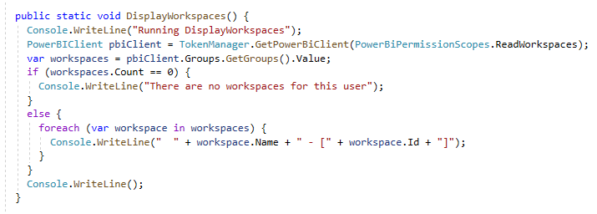
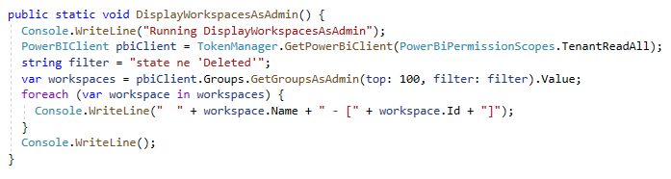
User API versus Admin API

Slide 12
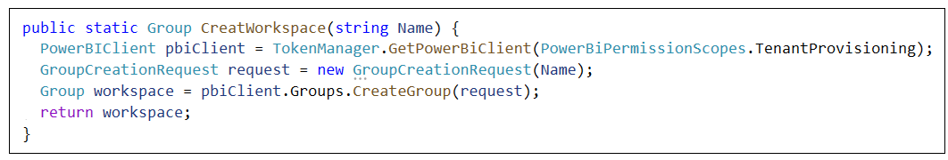
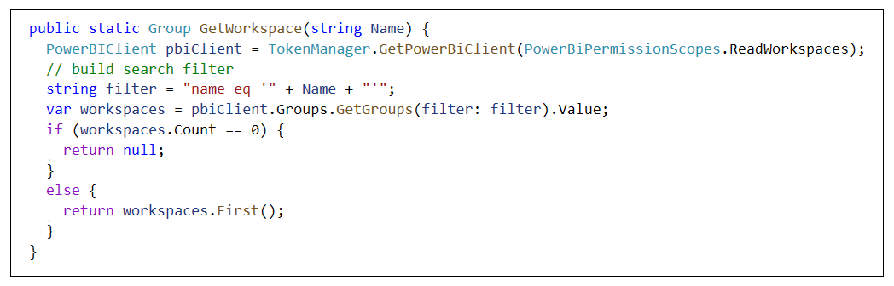
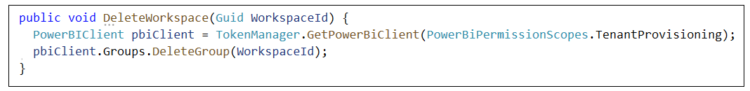
Creating and Managing Workspaces
Creating a new workspace
Getting a workspace by name
Deleting a workspace

Slide 13
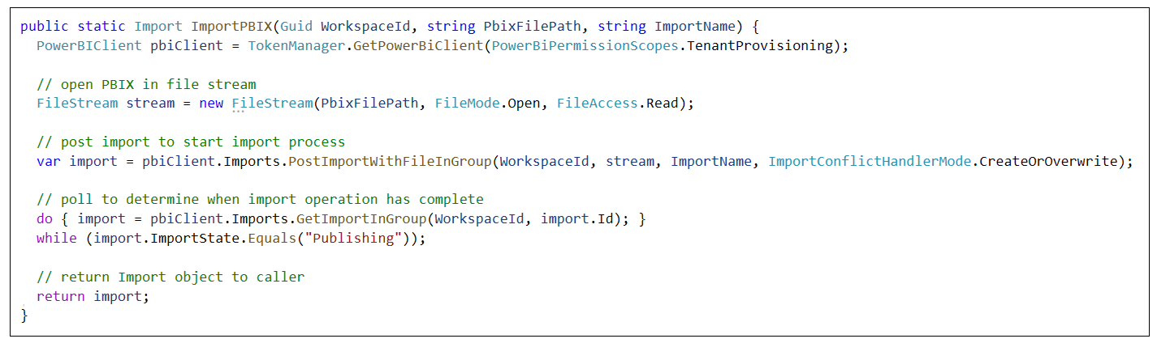
Importing PBIX Files
Importing PBIX from string-based file path

Slide 14
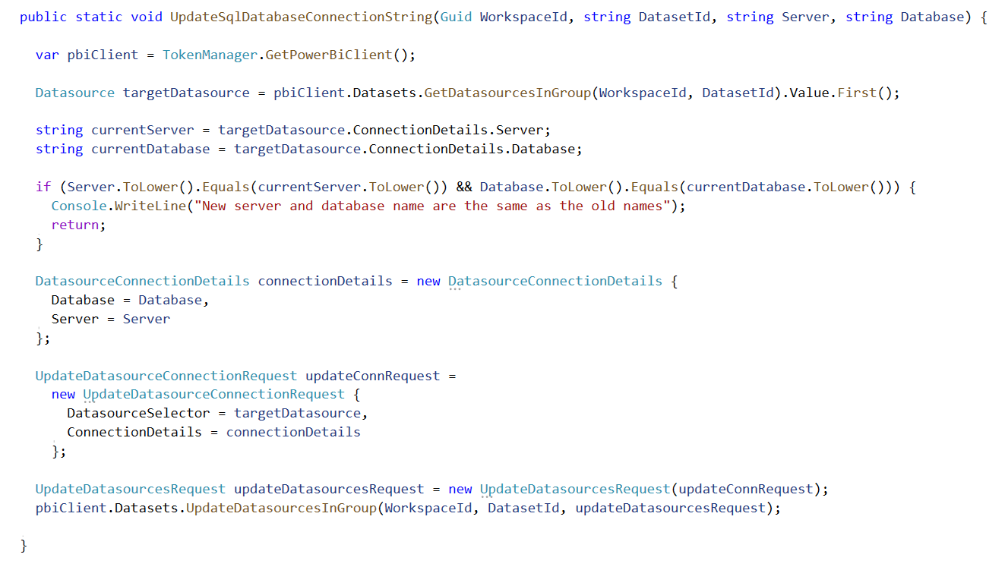
Updating a SQL connection string for a dataset

Slide 15
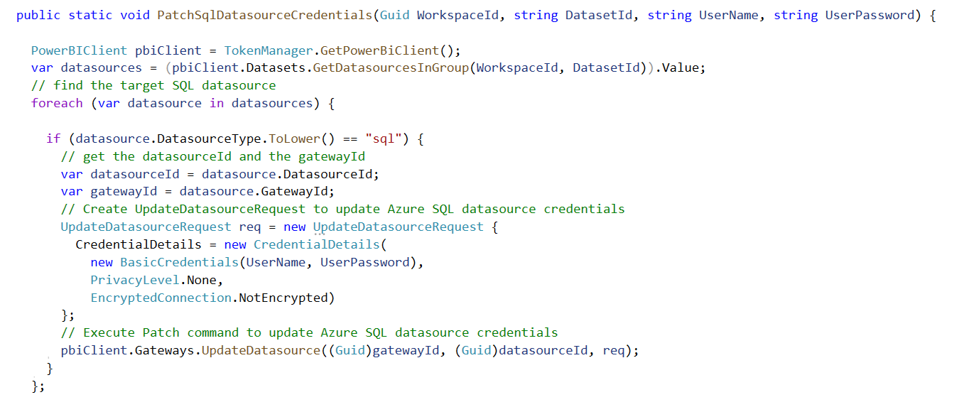
Patching SQL Datasource Credentials

Slide 16
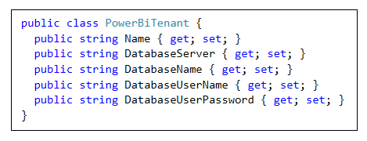
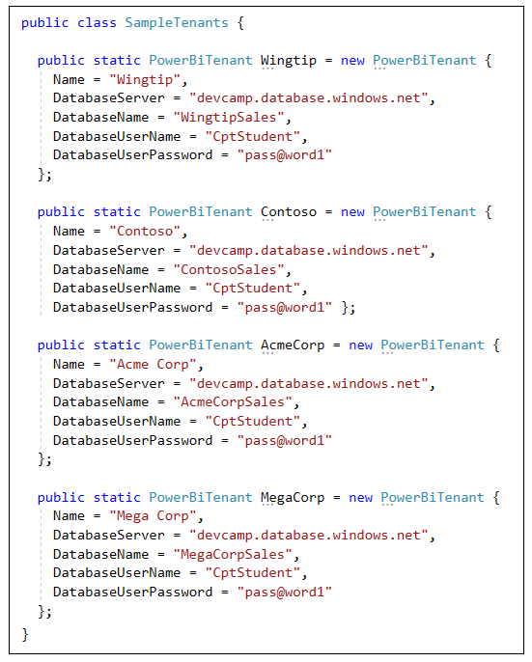
Samples Data for Tenant Provisioning

Slide 17
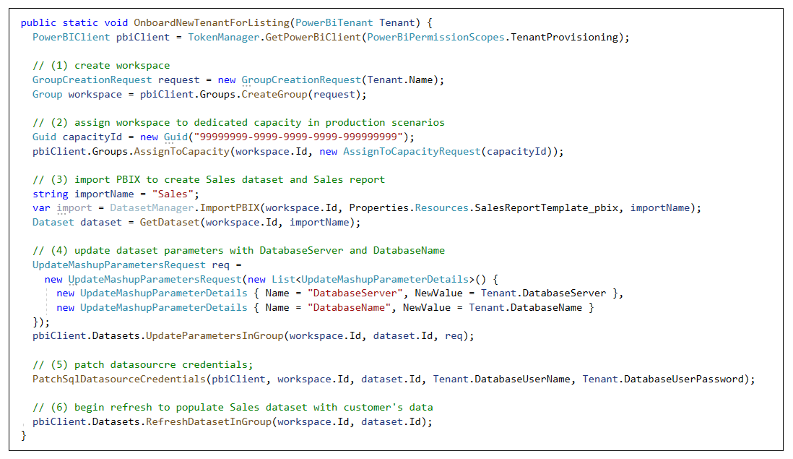
Tenant Provisioning Example

Slide 18
Agenda
Power BI Dataset Programming Overview
Programming Datasets with the PBI REST API
Programming Datasets as Service Principal
Programming Datasets using Tabular Object Model
Scaling with App-Owns-Data in Multi-tenant Scenarios

Slide 19
App-only Access Control
Service Principal used to configure access control
Requires the use of v2 app workspaces
Service principal added to app workspaces as admin
Access control NOT based on Azure AD permissions
App Workspace 1
Admins
User 1
User 2
App 1 Service Principal
Power BI Service
App 1 Service Principal
App-only Access Token
App Workspace 2
Admins
User 1
App 1 Service Principal
App 2 Service Principal

Slide 20
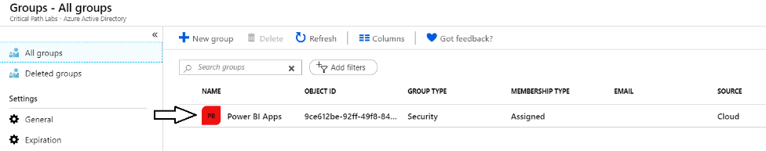
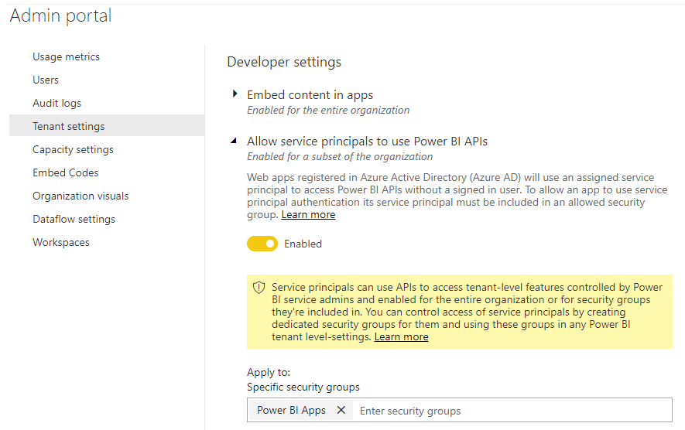
Setting Up for App-Owns-Data – Part 1
Enable Service Principal Access to Power BI Service API
Create an Azure AD security group (e.g. Power BI Apps)
Add group to Power BI Allow service principals to use Power BI APIs

Slide 21
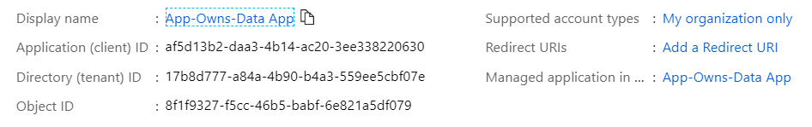
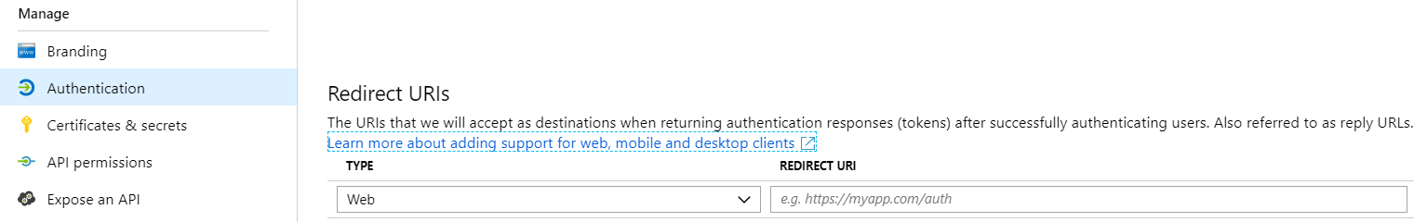
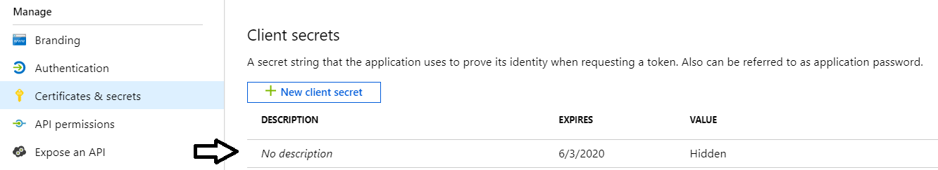
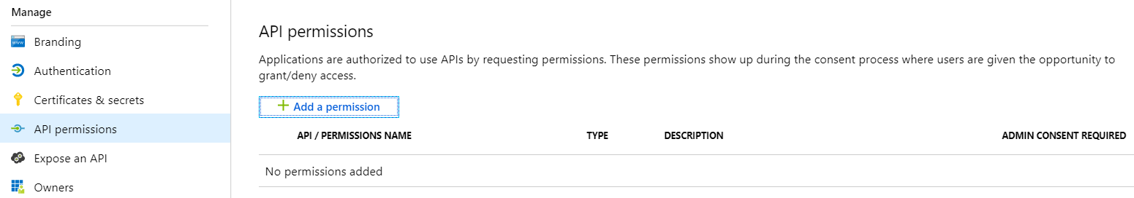
Setting Up for App-Owns-Data – Part 2
Create a confidential client in your Azure AD tenant
Configured as TYPE=Web and no need for a redirect URL
Add a client secret or a client certificate No need to configure any permissions

Slide 22
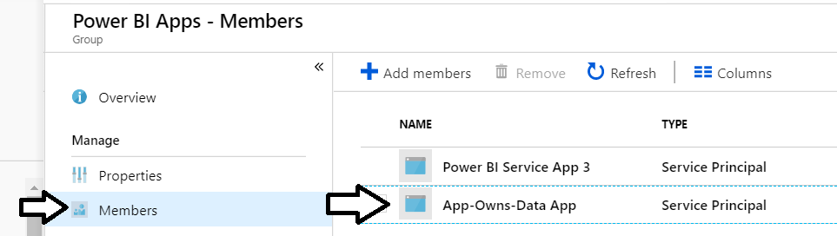
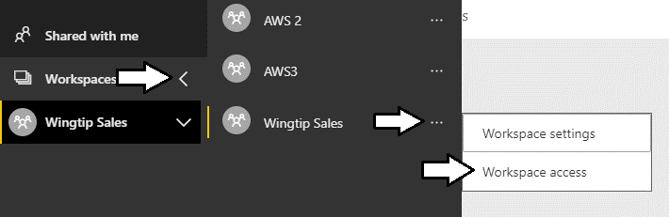
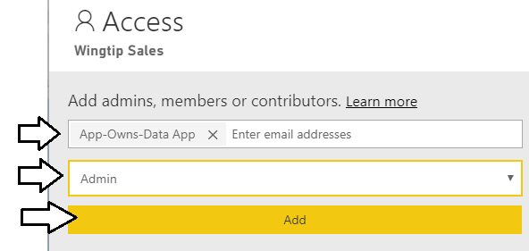
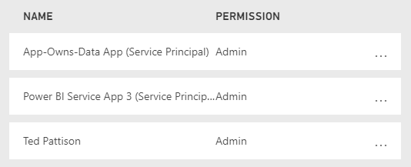
Setting Up for App-Owns-Data – Part 3
Add application's service principal in Power BI Apps security group
Configure application's service principal as workspace admin
Service principal should now be workspace admin

Slide 23
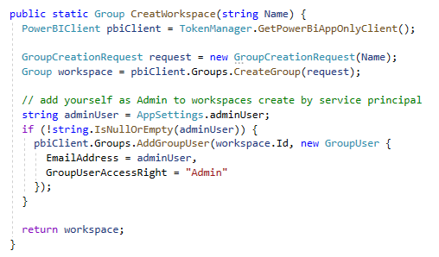
Calling the Power BI REST API as Service Principal

Slide 24
Agenda
Power BI Dataset Programming Overview
Programming Datasets with the PBI REST API
Programming Datasets as Service Principal
Programming Datasets using Tabular Object Model
Scaling with App-Owns-Data in Multi-tenant Scenarios

Slide 25
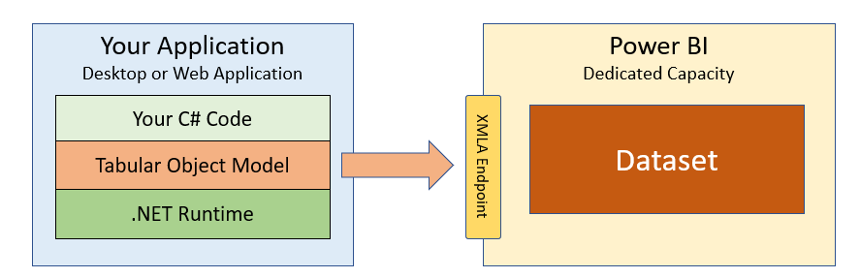
What is the Tabular Object Model (TOM)?
A new API for Power BI developers
Programming model built on XMLA Endpoint
.NET library with abstract layer over XMLA endpoint.
Requires Power BI datasets in a Premium capacity
CAVEAT – datasets modified with TOM cannot be downloaded as PBIX

Slide 26
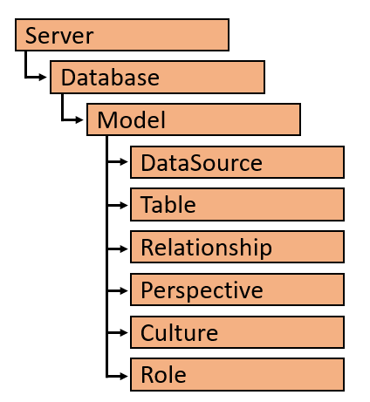
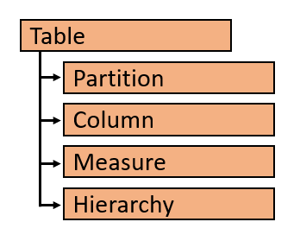
TOM Object Hierarchy

Slide 27
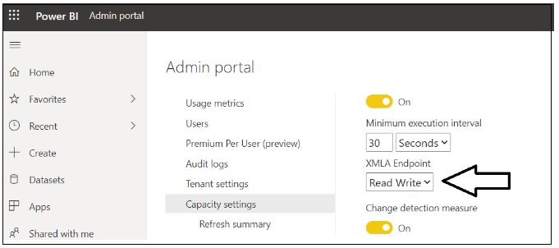
You must enable read/write access

Slide 28
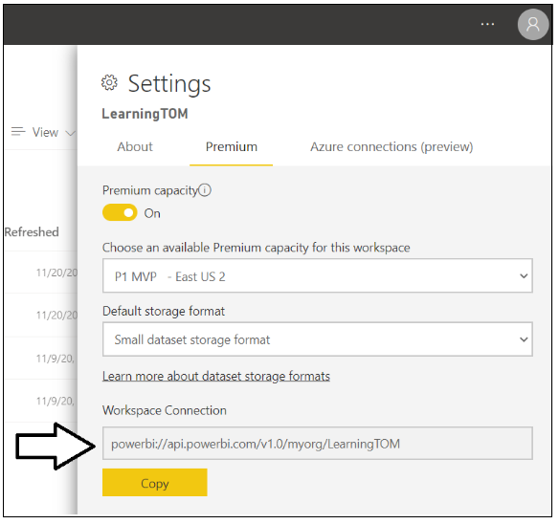
Workspace Connection

Slide 29
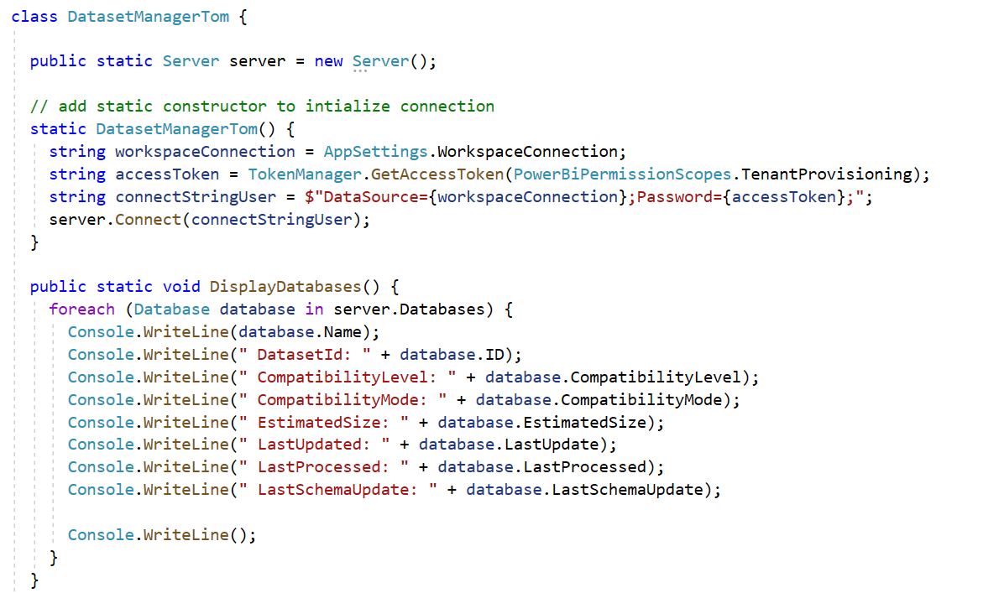
TOM Programming Samples

Slide 30
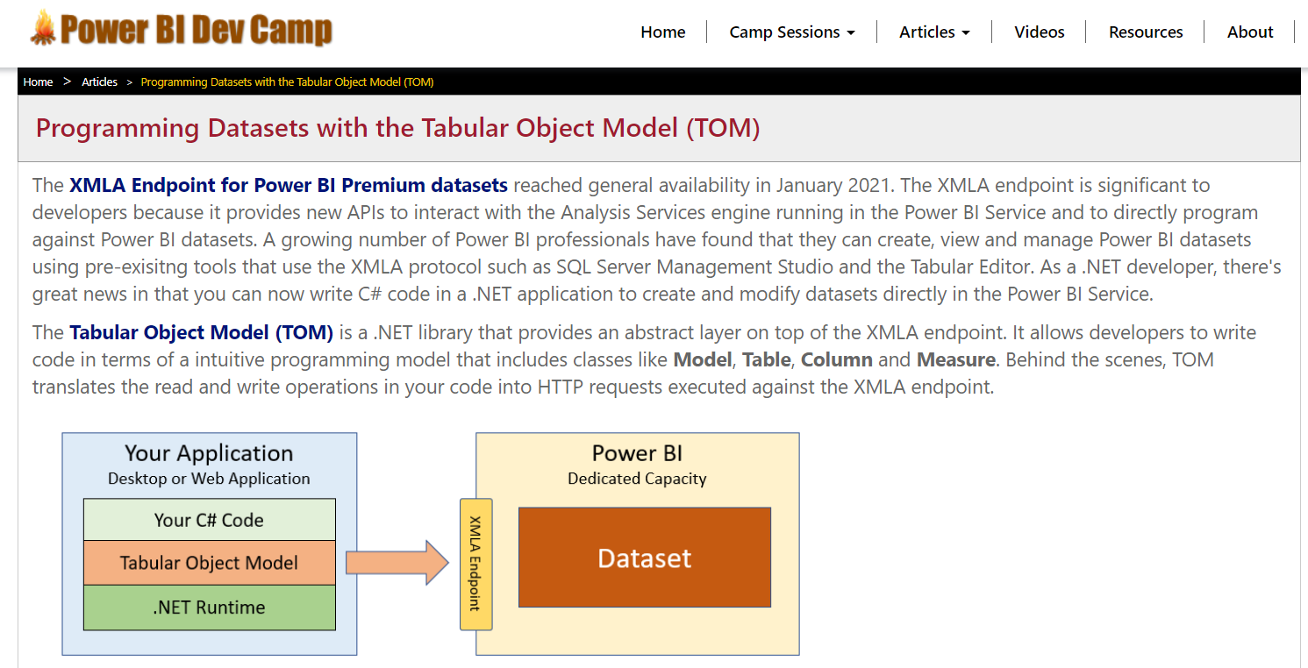
Getting up to speed on TOM
https://www.powerbidevcamp.net/articles/programming-datasets-with-TOM/

Slide 31
Agenda
Power BI Dataset Programming Overview
Programming Datasets with the PBI REST API
Programming Datasets as Service Principal
Programming Datasets using Tabular Object Model
Scaling with App-Owns-Data in Multi-tenant Scenarios

Slide 32
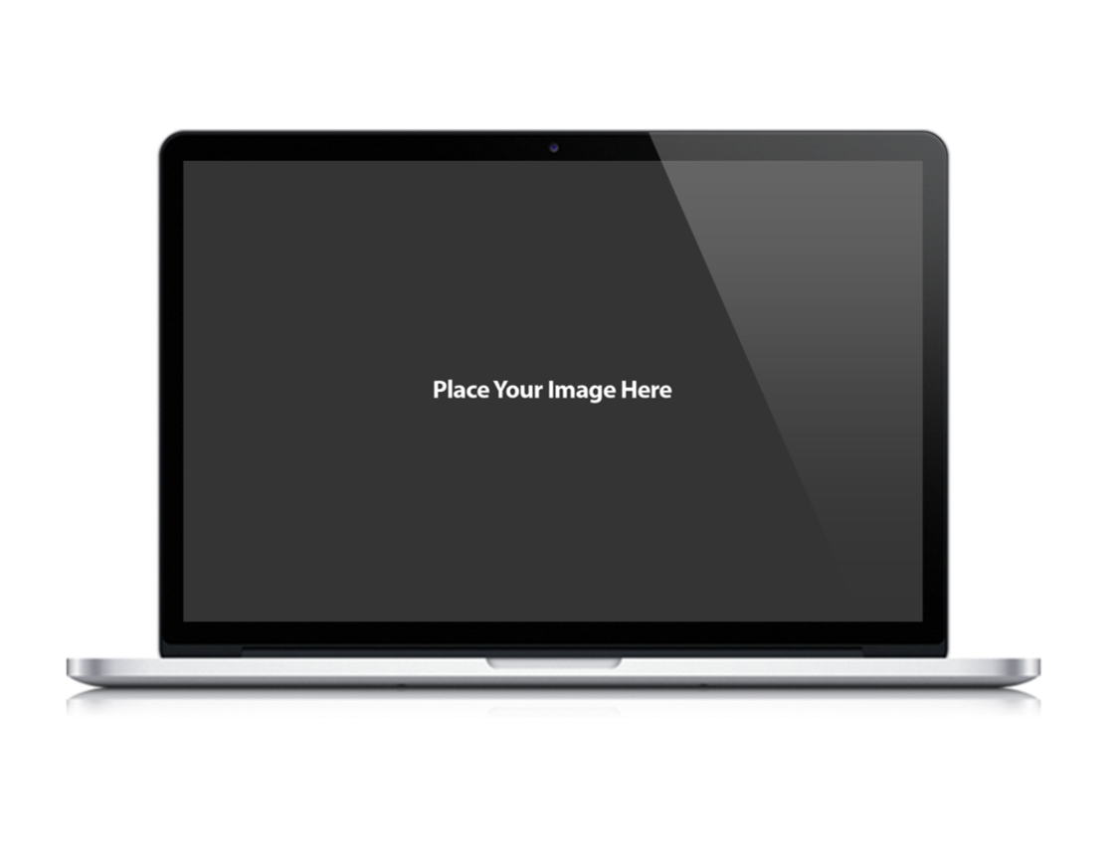
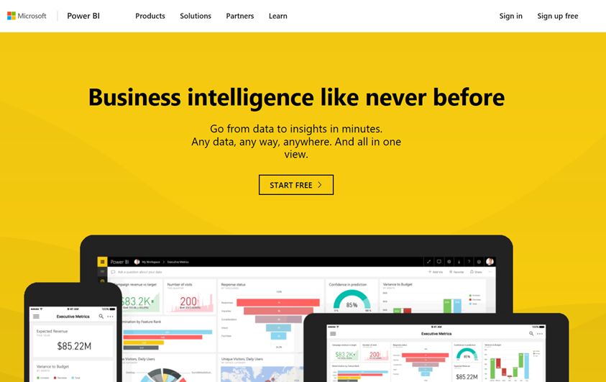
CAT
Microsoft Power BI
App-Owns-Data Starter Kit
Ted Pattison Power BI Customer Advisory Team (PBICAT)

Slide 33
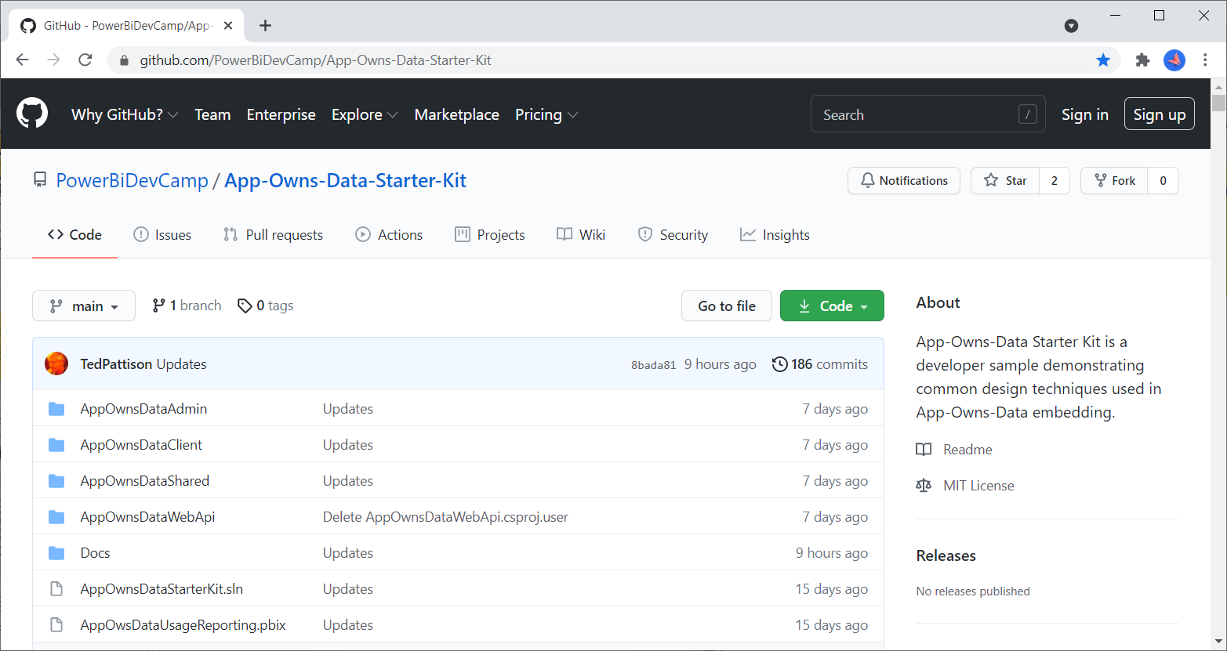
App-Owns-Data Starter Kit on GitHub
https://github.com/PowerBiDevCamp/App-Owns-Data-Starter-Kit

Slide 34

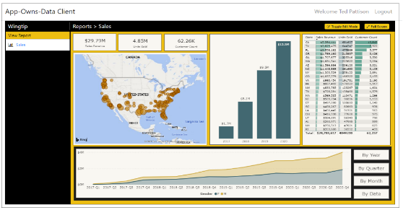
Customer Tenants in App-Owns-Data Embedding
Tenant represents a customer with one or more users
You must create a separate tenant footprint in Power BI for each customer
Power BI environment
Customer 01
17 users
Customer 01 Tenant
Sales
Power BI Workspace
Power BI Dataset
Datasource credentials
Power BI Report

Slide 35
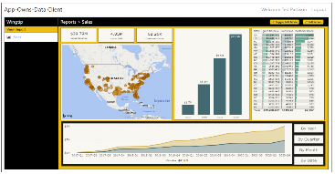
Designing a Multi-tenant Environment
Power BI Multi-tenant environment
Customer 01
17 users
Customer 01 Tenant
Sales
Power BI Workspace
Power BI Dataset
Datasource credentials
Power BI Report
Customer 02
243 users
Customer 02 Tenant
Sales
Power BI Workspace
Power BI Dataset
Datasource credentials
Power BI Report
Customer N
74 users
Customer N Tenant
Sales
Power BI Workspace
Power BI Dataset
Datasource credentials
Power BI Report

Slide 36
Solution Architecture
AppOwnsDataAdmin: administrative app to create tenants and manage user permissions.
AppOwnsDataClient: customer-facing SPA used to view and author reports.
AppOwnsDataWebApi: custom Web API used by the AppOwnsDataClient application.
AppOwnsDataAdmin
AppOwnsDataDB
Power BI REST API
AppOwnsDataClient
AppOwnsDataWebAPI

Slide 37
App-Owns-Data Embedding and Multi-tenancy
Tenant represents a customer with one or more users
you must create a separate tenant for each customer
Provisioning a new customer tenant
create a Power BI workspace
assign workspace to a dedicated capacity
import PBIX files
patch datasource credentials
start dataset refresh operations
create and bind gateway datasources

Slide 38
Web API Architecture
AppOwnsDataClient
AppOwnsDataWebAPI
Power BI REST API
Azure AD Client App
Azure AD Service App
AppOwnsDataDB

Slide 39
App-Owns-Data Starter Kit - Value Proposition
Provides guidance and starter code for the following tasks
Onboarding new customer tenants
Managing user permissions
Implementing the customer-facing client as a Single Page Application (SPA)
Creating a custom telemetry layer to log user activity
Monitoring user actions such as viewing, editing, and creating reports
Monitoring the performance of report loading and report rendering

Slide 40
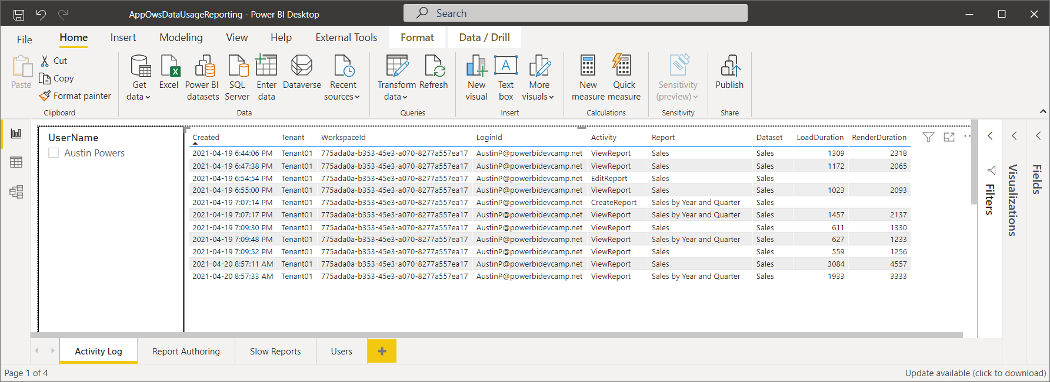
AppOwsDataUsageReporting.pbix

Slide 41
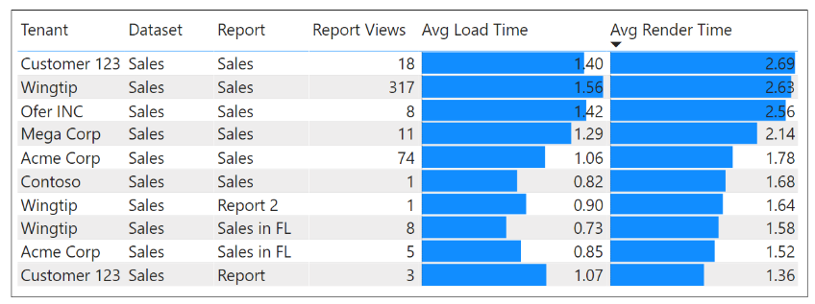
Monitor Report Performance

Slide 42
Summary
Power BI Dataset Programming Overview
Programming Datasets with the PBI REST API
Programming Datasets as Service Principal
Programming Datasets using Tabular Object Model
Scaling with App-Owns-Data in Multi-tenant Scenarios

Slide 43
Microsoft Power BI
Questions?

